Slide 1
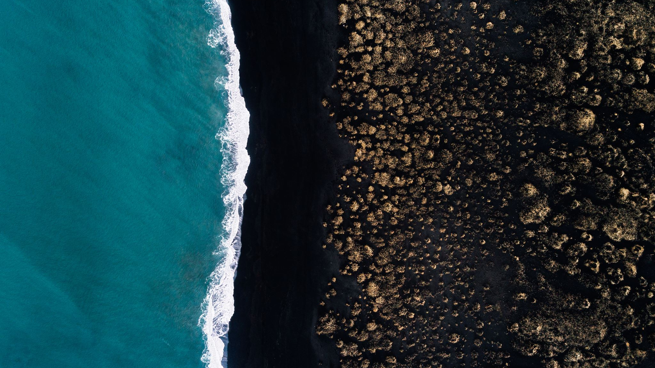
Week 3
LIBS1960
Prof. BRandi May

Slide 2
Agenda
Recap from last week
Introduction: Myths of Origin
5 Races
Prometheus
Break Time
Pandora
Flood
In-Class Activity 2
Wrap Up

Slide 3
RECAP
Please go to www.Kahoot.it

Slide 4
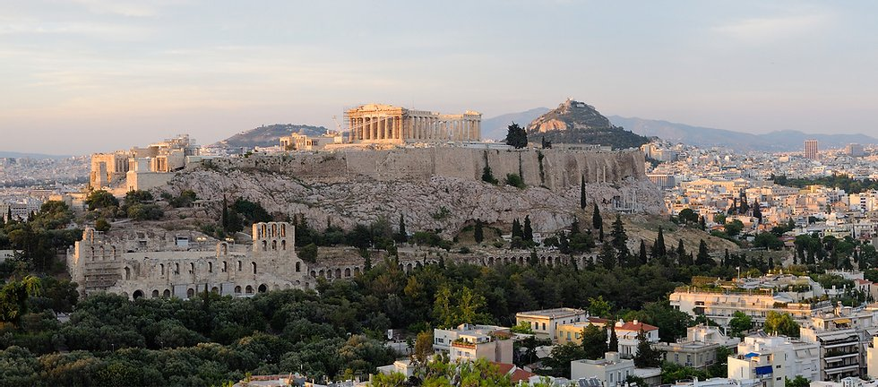
Introduction: Myths of Origin
We know from last week why people are so concerned with the Gods and their origin
Why do you think people spent time and energy considering myths of human origin?
Notes:
Image retrieved from https://www.helenloverdou.com/?lightbox=image2rl

Slide 5
Myths of origin
Generally speaking, there are more myths about the origin of specific locations such as Troy or Thebes
That being said, there are a few myths that deal with the origin of humans in general
The myths we will discuss today are: The 5 races, Prometheus, Pandora, and the Flood.
The first three come from Hesiod's Works and Days

Slide 6
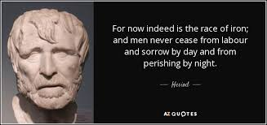
The 5 races
1. Race of Gold
2. Race of Silver
3. Race of Bronze
4. Race of Heroes/Stone
5. Race of Iron
Who remembers from last week why Hesiod might have thought this way?
Notes:
Image retrieved from Hesiod quote. Retrieved from https://www.azquotes.com/quote/1236317

Slide 7
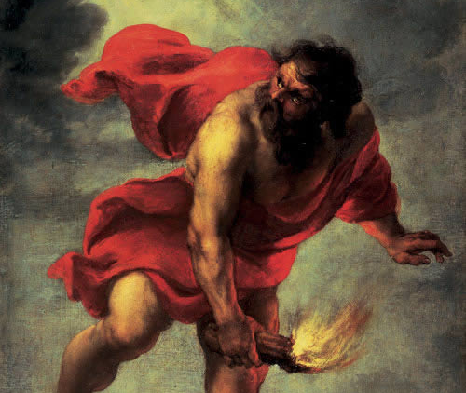
Prometheus
Notes:
Image retrieved from Prometheus. Retrieved from https://www.greekmythologyinart.com/prometheus.html

Slide 8
Who is Prometheus?
Prometheus (meaning fore-thought) was a second-generation Titan, son of Iapetus
Last week, we talked about how all of the Titans were sent to Tartarus after their defeat, but Prometheus, and his brother Epimetheus, were spared
Considered both a creator of humans and a champion of humans

Slide 9
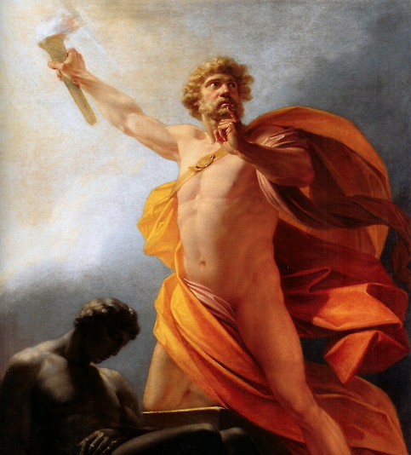
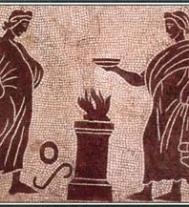
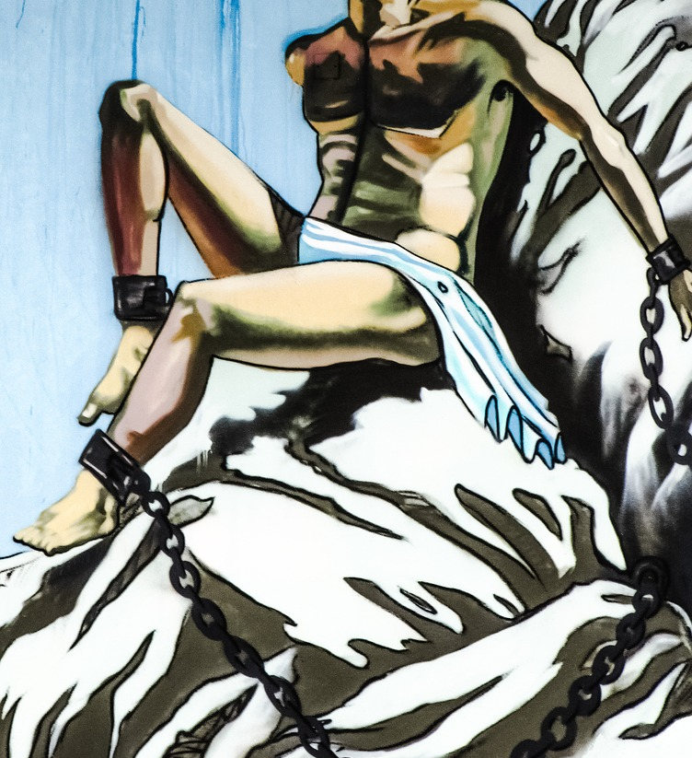
Story of Prometheus
Notes:
Image 1: http://www.mythencyclopedia.com/Pa-Pr/Prometheus.html
Image 2: https://en.wikipedia.org/wiki/Theft_of_fire
Image 3: https://pixabay.com/photos/prometheus-chained-man-rock-1902749/

Slide 10

Break Time

Slide 11
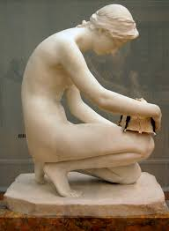
Pandora
It was not enough for Zeus to punish Prometheus, he also needed to punish humans, so he asked Hephaistos to make Pandora to seduce Epimetheus
As a wedding gift, Zeus gave Pandora a pithos (large jar) but told her NEVER to look inside
Notes:
Image retrieved from https://commons.wikimedia.org/wiki/File:Harry_Bates_-_Pandora,_1891,_right_-_on_temporary_display_at_Tate_Britain,_September_2010.png

Slide 12
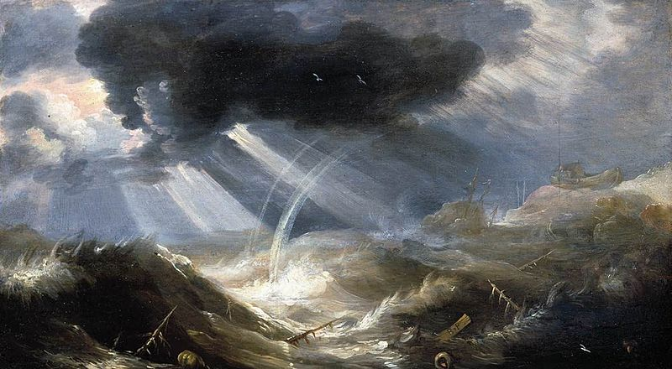
Great Flood
This story ties in both the 5 races and the story of Prometheus
Deukalion was the son of Prometheus and his wife Pyrrha was the daughter of Pandora and Epimetheus
Deukalion and Pyrrha lived during the Bronze age of man
Notes:
Retrived from https://www.greeklegendsandmyths.com/deucalion.html

Slide 13
The Flood Story
Zeus wanted to rid the world of the Bronze age of man so he sent a flood
On the advice of his father, Deukalion build a boat that he and Pyrrha would float on for nine days and nights
Eventually, they sacrificed to Zeus who allowed them to re-populate the earth
Both Pyrrha and Deukalion threw stones over Deukalion's head to create humans.
This was the beginning of the next race- the Stone/Hero race.

Slide 14
In-Class Activity 2
please consider the four-fold framework of understanding myths:
1. Socially Powerful
2. Symbolic
3. In a narrative-based format
4. Tells of the possibilities of human experience at the time
In your group, please create paragraph-long discussion post that answers the following question:
Which of the four categories above help you to understand your assigned myth? Why?
Groups 1-2: 5 Races
Groups 3-4: Prometheus
Groups 5-6: Pandora

Slide 15
Wrap Up
If you haven't yet, please sign up for a presentation date by going into Course Tools>Groups and choose a time
Next week: Please read pp. 68-88
As a reminder, you should be doing the 'asynchronous' activities. These are part of the course and are subject to testing.
If you have any questions, please feel free to reach me at bmay@conestogac.on.ca

